Slide 1
GOMYCODE
Presentation:
How does the web work?
What do you need to be a web developer?
Why did I choose to learn web development?
by hadj said yacine

Slide 2
How the Web Works
When you enter something like google.com the request goes to one of many special computers on the Internet known as Domain Name Servers (DNS). All these requests are routed through various routers and switches. The domain name servers keep tables of machine names and their IP addresses, so when you type in Google.com it gets translated into a number, which identifies the computers that serve the Google Website to you.
When you want to view any page on the Web, you must initiate the activity by requesting a page using your browser. The browser asks a domain name server to translate the domain name you requested into an IP address. The browser then sends a request to that server for the page you want, using a standard called Hypertext Transfer Protocol or HTTP.
The server should constantly be connected to the Internet, ready to serve pages to visitors. When it receives a request, it looks for the requested document and returns it to the Web browser. When a request is made, the server usually logs the client's IP address, the document requested, and the date and time it was requested. This information varies server to server.

Slide 3
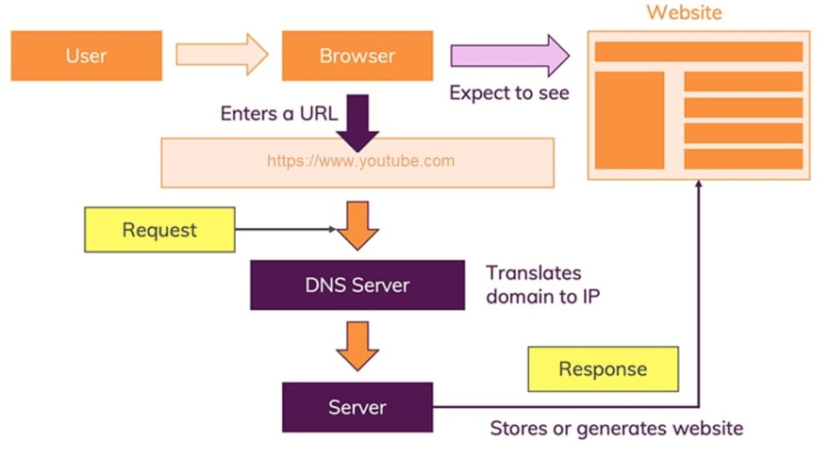
An average Web page actually requires the Web browser to request more than one file from the Web server and not just the HTML / XHTML page, but also any images, style sheets, and other resources used in the web page. Each of these files including the main page needs a URL to identify each item. Then each item is sent by the Web server to the Web browser and Web browser collects all this information and displays them in the form of Web page.

Slide 4
What do you need to be web developer?
1. Learn Web Development Fundamentals
2. Choose a Development Specialization
3. Learn Key Programming Languages for Web Development
4. Build Projects to Develop Your Web Developer Skills
5. Build a Web Development Portfolio

Slide 5
Why did I choose to learn web development?
Web gave us all a lot. I want to thank each and everyone who put their work in making our life easy and that is why I choose to be a web developer Now it is my turn to make people life easy and make this world a better place.

